Slide 1

HOW TO BE A BETTER SECURITY PRACTITIONER
Seger Steele
SegerSteele@outlook.com
Notes:
Good afternoon, everyone! You know, I woke up this morning and thought, why Seger? Why do you do this to yourself?
I don’t know about you all but I dread public speaking. (chuckle)
All jokes aside, I'm Seger Steele and we will be covering how to be a better security practitioner today.

Slide 2

$whoami
Cloud Security Engineer with Arcadia Solutions, a healthcare analytics SaaS provider.
4+ years experience spanning multiple security domains, including IR, GRC, IAM, and Engineering.
Industry exposure ranging from a manufacturing/retail enterprise to SaaS start-ups in the healthcare space.
Vivid gamer at heart.
ENFORCE AUTH-APP BASED MFA!
Notes:
So lets jump into a classic whoami intro slide.
You may notice the yelling bunny on the slide, that’s my pet Lucky and he is also passionate about security.
Currently a Cloud Sec engineer with Arcadia. Arcadia is a healthcare analytics SaaS provider for medical providers and insurance payors. Over the last close to 5 years, I’ve been fortunate enough to be exposed to several domains of security and my favorite so far has been engineering.
I got my start as a IR for Valvoline in Lexington while finishing my studies at EKU, since then I have stayed with SaaS provider start ups.
Lastly, I love to game, quick show of hands anyone running with Starfield or Assassins Creed?

Slide 3
Agenda
Identify and Communicate Gaps
Collaborate and Leverage External Teams
Be a Constant Learner
Stay Current
Invest in Yourself
Notes:
Alright everyone let's hop into our agenda.
Well start with Security Gaps -Training the mind how to identify security gaps and then communicate how to fill those gaps in a way that will get you traction. Not get blocked
Then well tackle collaboration with external teams - How to communicate and collaborate with other teams outside of security and how we can leverage them for security initiatives.
Everyone in this room is aware of how our field is constantly changing, so well discuss Adopting and nurturing a mindset of constant learning and some of the ways I’ve found work best for keeping up with the latest in our field.
Finally, we will wrap up with investing in yourself, both for technical skills and taking care of your mental health.
Okay lets jump in!

Slide 4

Identify Security Gaps
What new security control can increase our security posture?
Where are we missing visibility?
Can our detection, triage, or containment processes be more efficient?
What features do we have access to but don’t fully use?
Understand the future compliance and cybersecurity maturity target.
What controls are missing from the selected security framework?
What domains have the lowest maturity score?
What pain points exist in the current tool stack/processes?
What gives everyone a headache?
Notes:
To kick us off, lets tackle identifying security gaps.
A great start is to answer the question, what new security control can increase our security posture?
Visibility:
Do we currently have any centralized logging like with a SIEM?
Can more log sources be onboarded that aren’t currently?
IR: Can we automate runbooks? If we witness a MFA Fatigue attack with high confidence it’s a true positive, can we automatically reset the users credentials?
Features: I encourage you to look at your tech stack and thoroughly examine settings for either direct security settings that could be enabled or integrations that could be beneficial (i.e. Can we ship these logs to a SIEM)
Future State:
If part of your security roadmap includes undergoing an audit and passing for a more robust security framework, what controls aren’t currently implemented today?
Pain points: Raise your hand if you love dealing with inventory management? How about vulnerability management?

Slide 5
Communicate Security Gaps
Be sure to have at least 1 well-documented solution for each gap.
Bringing up problems with no solution can be perceived as complaining.
Complete your due diligence.
How will this impact end users?
What other teams need to be involved?
What is the net gain for our security posture vs. the effort to implement this?
How can this go horribly wrong?
Less is more. Progress not perfection (at least to start).
Practice condensing the most valuable information and make the delivery as concise as possible.
Ensure you taking incremental steps to address the gap or reduce the risk.
Notes:
So you’ve identified a gap, now what? When we call this out to the team or your manager, make sure to have 1 well thought out solution to fixing this gap. If you have documentation from vendors or self made to back this up even better.
I was once told that if you're bringing up problems with no solutions, you're simply complaining. A little harsh but its mostly true.
So how can we go about documenting our solution?
We’re going to complete thorough due diligence!
A simply way to think of completing this, is map your solution back to who, what, when, how and why. Right?
You're going to see several questions that should be asked on the slide, my favorite being how can I royally eff this up? There has been than once after making a production change where I wish I spent more time on this question.
Lastly less is more. There is principle I learned at EKU called brevity upward, clarity downward. Unless you're giving instructions, keep it as concise as possible.
Also, it doesn’t have to be perfect. Fail forward. Progress is better than sitting on your hands thinking of the best way forward.

Slide 6

Collaboration with external teams
Focus on building strategic partnerships.
There is mutual benefit for both parties.
Does Security feel siloed?
Not sure where to start?
Integrate security members into other team’s stand-ups.
Openly share the threats the company faces.
Lays groundwork to justify security initiatives.
Notes:
Alright, lets shift to collaborating with and leveraging other teams.
It really helps to frame it, both to the security team and the other teams, as you're looking to build partnerships. Both teams should benefit from this. We’ll break this down more on the next slide.
Quick show of hands, who has heard the phrase at work, “Security is a black box.” Or perhaps you feel that you're being blindsided by other teams requests, and maybe they say the same about Security?
A great starting point, depending on your team's size, is to integrate team members into other teams weekly stand-ups. Typically this will be the most “security-adjacent” teams, the classic partners like IT, or Infrastructure.
By doing this, both teams have dedicated time each week to discuss opportunities where we can help each other out.
The last note we will cover here, is more focused on broadcasting information than a partnership. Openly tell the company what threats you face.
If you're in leadership, share with the board, executive committee etc what attacks you're seeing. Outside of leadership, send out all staff emails or, if you use it, all staff slack channels, to alert staff of ongoing persistent phishing attacks and what to look out for. For example, if youre seeing perisitent docusign themed phishes, include some examples of recent attacks and highlight for your end users what signs to look out for, like the sender domain, suspicious links and more.
This will help justify the security budget and further initiatives.

Slide 7
Collaboration with external teams
What teams?
IT – Automating account provisioning/deprovisioning.
DevOps – Securing infrastructure.
Data – Establish standards for storage/transfer of data, especially sensitive data (PHI, payment info).
Product – Shift security left and secure what's coming down the pipeline sooner.
Finance – Mature the approval process for corporate payments. (i.e., Wires)
Marketing/Sales – Give them resources, like a trust portal, to speed up transactions.
Notes:
So here we will do a rapid fire of external teams and a example use case for collaboration with that team.
IT: Onboarding a SSO provider and configuring the roles for role-based access.
DevOps: If they’ve been constrained and unable to tackle open security items, can we help them enforce controls ranging from enforcing MFA, ensuring encryption on S3 buckets and EBS volumes, WAF configuration I mean the list goes on.
Data: If you’re working with customers or partners and sharing data, PHI for example, what standards are in place? If someone didn’t follow the standard, how would you know? Can you audit the process easily?
Product: We’ve all heard we about shifting security left. At a previous company, we would have a monthly 30 minute touch point with the Head of Product and product managers to dicuss the pipeline. Now we wouldnt fix all of our concerns at the meeting, but we could call attention to the concerns and being to address from there. Getting a security practitioner’s eyes on the product pipeline sooner helps us chime in before too much foundational work has been completed.
Finance: More than four out of five companies said they were the target of pay­ments fraud in 2019, according to a survey by the As­sociation for Financial Professionals. Locking down the approval process for payments will help deter, prevent and catch cases of fraud.
Marketing/Sales: Weaponize your security posture, be loud and proud to prospective customers about how secure you are. A trust portal is a good public facing resource where people can see at a high-level certifications along with overviews. Arcadias trust portal for instance, lets you request copies of policies, audit findings, pen test results and more.

Slide 8

Staying current with threats/trends/news
RSS Feeds
CISA Advisories: https://www.cisa.gov/cybersecurity-advisories/all.xml
Krebs on Security: https://krebsonsecurity.com/feed
Bleeping Computer: https://www.bleepingcomputer.com/feed/
The Hacker News: https://hnrss.org/newest?q=Vulnerabilty
Reddit
Some vendors support their subreddits, such as ‘r/crowdstrike’
r/cybersecurity
r/Infosec
Get involved with the security community.
Notes:
Okay so staying current; we all have our favorite security news channels, but this focusing more on how you get that information versus where you get it.
For those who aren’t familiar, RSS Feeds regularly publish content from media sites, and you can subscribe to RSS feeds. I have a few of my favorite RSS feeds on the slide that I’m sure you all are mostly familiar with.
if you google, 'Cyber Security Rss Feeds' the first result is a list of 100 different RSS feeds you can subscribe to.
Some feeds can even be customized, for example, The Hacker News link here is filtered to show me the newest articles that contain a title of vulnerability.
Every company I’ve worked for has used Slack in some capacity. If you also use Slack, there is a RSS Feed app. You can create a private channel for security news and ingest all of the feeds into it.
This fosters collaboration as we can in real time comment and discuss what we see. For example, we have a new zero-day article pop up. We can discuss if we’re exposed and create a formal process to remediate it within a ticketing system like Jira.
It’s also helpful to have a few leaders from other teams, like IT and DevOps, to call out things they may own and make it easier to collaborate with these teams.
Everyone knows what reddit is so no background needed there, but I’ve listed some decent subreddits, and some vendors like crowdstrike actively support their subreddits. Meaning you can ask technical questions about agents, issues you're facing and new features and get a response from a employee.
Oneof the best to stay current is doing what we’re all doing right now, getting involved with our community! Outside of conferences, you can attend free webinars from vendors or organizations like HISAC. SANS also have free workshops and remote conferences. They had one on AI over the summer that had some excellent speakers.

Slide 9

Constant Learning Mindset
Embrace feedback.
Feedback can come from peers as well as other managers.
Volunteer for tasks that you're interested in, especially if its something you’ve never done before.
If you know your ideal career trajectory, start seeking out tasks that align with your goals.
How can you help others grow?
Morty expressed interest in learning firewall management, how can Rick expose him to this?
Invest in yourself!
Notes:
So moving on to the constant learning mindset. In our field, if we cease to stop learning new skills we will become antiquated and our peers who stay current will be more valuable.
The first topic is straightforward, embrace feedback! Seek it out, constantly. Not just from your manager but from your peers. If you're collaborating with someone on a project, at the wrap up ask if theres a way you could've performed or interacted that would have been better.
Constructive feedback isn’t the end of the world, for example, if you were approach me after this talk and tell me that you didn’t like my session and it was a waste of time. Great! Tell me why? What could I have done differently?
Next up is volunteering for as much work as your bandwidth can handle. Especially if you're interested in it! If you're a engineer but want to shift into GRC; start seeing what tasks you can do for your GRC team. Can you automated time bound tasks? Can you help manage any tools they use or set up new integrations for solutions like Vanta? Ideally the more you're exposed, the more work of that nature you can list on your resume.
With volunteering, tie this back into security gaps from earlier. If you notice a gap, volunteer to tackle it!
Lastly, lets quick focusing on ourselves; how I can help my teammates grow?
So for example, Morty wants to start getting into firewall management. How can Rick, who owns this process, help expose him to it? Rick can let Morty shadow him then if that goes well let them start completing the task. Perform QA on the work Morty does of course, Morty may and likely make mistakes at first, but letting Morty take this will increase his job satisfaction, which is good for the company, for him and for the team.
And to lead us to the end of our slides, Invest in yourself!

Slide 10

Investing in yourself – Technical
CTF’s
SANS Holiday Hack Challenge
Platforms (HackTheBox, TryHackMe, LetsDefend)
HTB Business CTF
Certifications
Deepen knowledge of your stronger skills.
Shore up gaps in your skillset.
Not all certifications are made equal.
https://pauljerimy.com/security-certification-roadmap/
Notes:
We’re going break this up in 2 sections, investing in your skillset and investing in your mental health.
Starting off with your skillset will be straight forward, to start with well cover CTF’s and certifications.
SANS offers a free Holiday Hack Challenge CTF each year around the December holiday season. Its interactive and is another great way to stay involved in the community.
Ill be covering Platforms more on future slide, but for now just keep in mind HackTheBox and TryHackMe are great for learning offensive skills, with TryHackMe being more beginner friendly. LetsDefend is a solid blue team CTF site, where your flag might be a certain value you’re trying to comb out of logs.
HTB also offers a Business CTF where companies can sign up their security teams for free to compete for cash prizes, this year the total prize pool was 50k. It’s a great way to build camaraderie with your team as well.
Certifications are and will remain a hot topic in our field. I believe they serve 2 primary purposes. To deepen your existing skill set, and to shore up gaps in your skillset.
Not all certifications are made equal, If you include vendor certifications, there's literally hundreds of certifications and it can be overwhelming especially if youre new to the field.
In my opinion, the only vendor certifications I aim to get are from the big 3 cloud providers, while organizations like SANS, ISC2, COMPtia, ISACA, and many others offer great vendor-agnostic certifications.
You will notice a hyperlink to paul jerimys security certification roadmap, lets dive into this on the next slide.

Slide 11
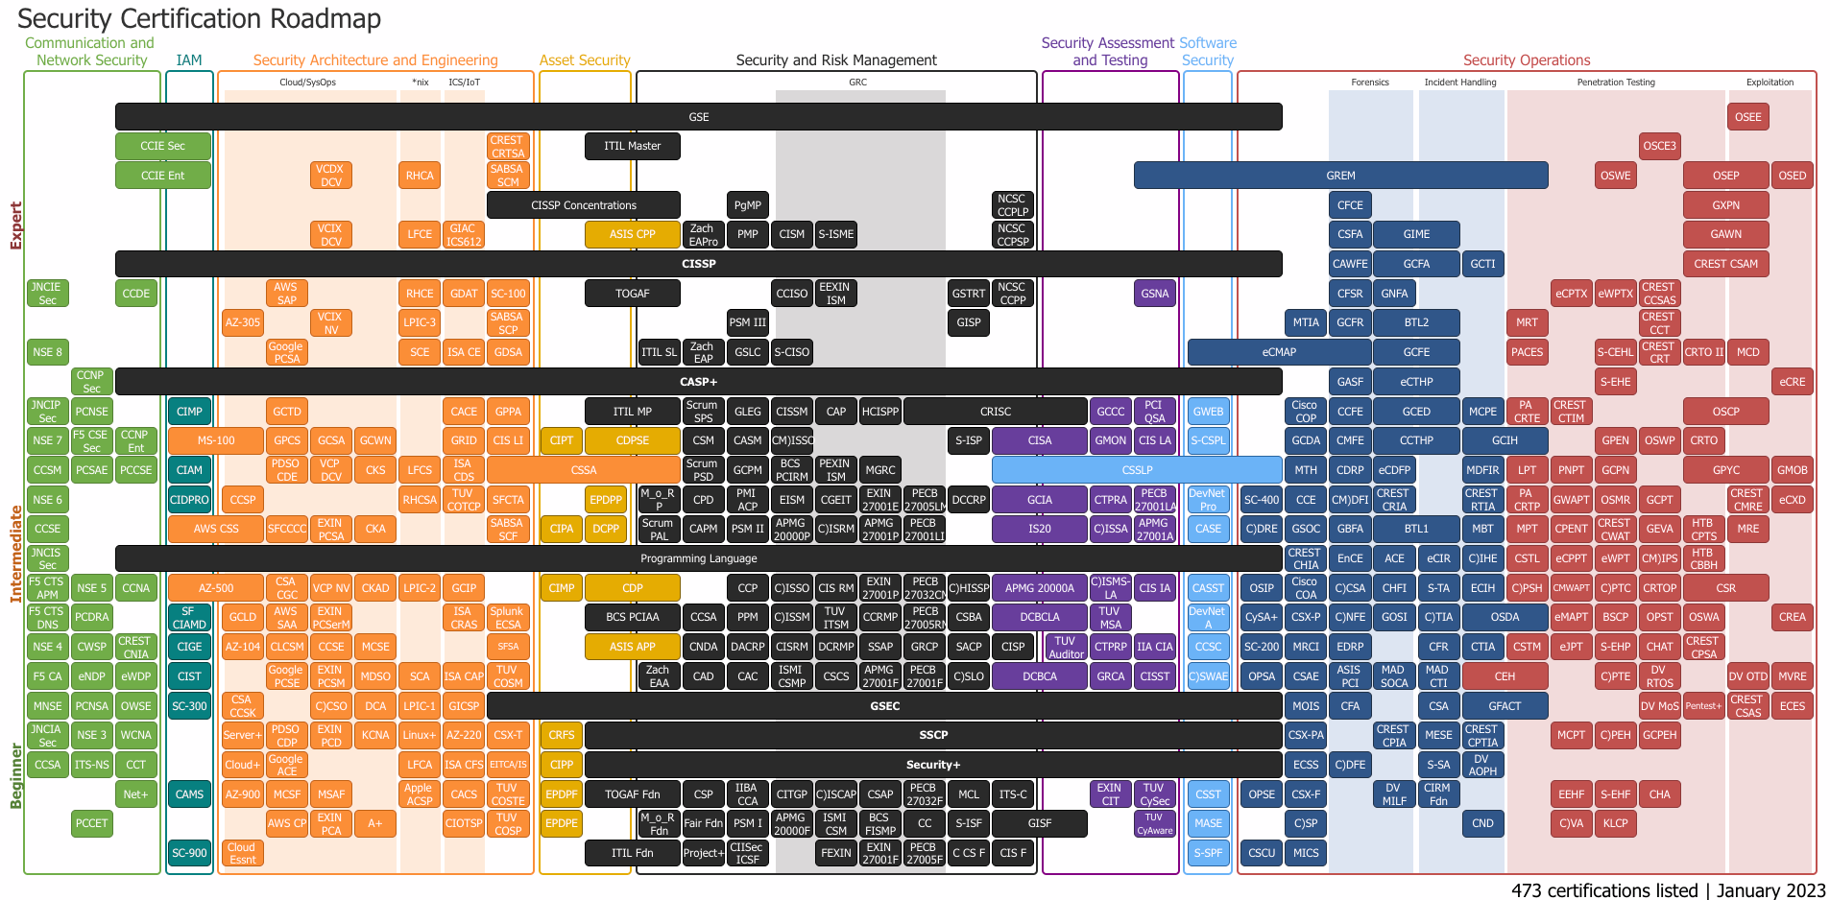
Investing in yourself – Certifications
Notes:
Quick show of hands, who has seen this before?
So the y-axis goes from beginner to Expert with the x axis supporting different domains in security.
On the website, hovering over each certification will tell you how much it costs, a link to the certification page and the format! Format being things like; exam, labs, interview, all of the above, etc.
Now, it doesn’t have every certification from every vendor, which is part of the draw.
They are limited vendor specific certifications on here, you’ll notice the big 3 cloud vendors on here but outside of them there is limited vendors. No Crowdstrike certifications are listed for example.
Let's finish, up investing in your skill set on the next slide.

Slide 12
Investing in yourself – Technical
Platforms
HackTheBox
CloudGuru
TryHackMe
Home labs
Deploy a SIEM (Splunk), ingest syslog, router logs, and any application logs.
Deploy a EDR (Huntress), on a VM, run a EDR test script and review the results.
Open a cloud provider account (AWS), spend time understanding services.
Notes:
Alright, I mentioned CTFs earlier and a great way to consistently play them, and track your progress is with platforms like HackTheBox and TryHackMe.
I personally prefer and use HackTheBox, they’ve historically been the the platform that doesn’t do much ‘hand holding’, but lately they’ve been making their boxes more inclusive for beginners.
Another platform to check out is CloudGuru from Pluralsight. For those who aren’t familiar, they offer amazing training for the big 3 cloud providers along with with other categories like Terraform for example.
Last topic I’ll touch on for investing in your technical skills are home labs.
If you're interested in a certain technology or vendor, consider installing and configuring security solutions on your home devices/network.
There's tons of use cases for a home lab, but here are a few that I’ve done in the past.
Use the free trial of Splunk or your SIEM of choice and ingest logs ranging from syslog to audit logs from your password manager.
Deploy a EDR agent to a VM, I used the free trial of Huntress, then found a script on github that’s sole purpose is test the detection capability of EDRs. Remember to turn off prevention capabilities before running the script.
Finally, you could open a cloud provider account and just spend time getting familiar with the console and different services. I did this in AWS, but any vendor will do. Just be conscience to tear down any infrastructure you spin up.

Slide 13
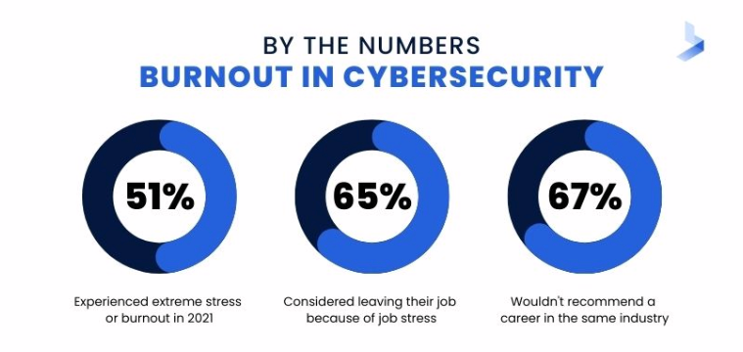
Investing in yourself – Mental
Take care of yourself.
Make time daily to destress.
Walk on lunch/after work
Meditate
Set boundaries.
“My bandwidth is at capacity, If I take this on what would you have me deprioritize?”
Check-in on your teammates.
Notes:
We’ve all heard about burnout in security, burnout can feel like a state of complete mental, physical, and emotional exhaustion. If you are experiencing burnout, you may notice it is difficult to engage in activities you normally find meaningful.
Quick show of hands, who has felt this before? I know I have.
A study by Bitlyft found that 51% of surveyed have experienced severe stress or burnout. With 65% having considered leaving their role because of stress.
If we wait until we’re burnout out, we can be in trouble. Imagine getting that incident phone call when you're unable to be there 100%. We have to catch it before it gets there.
How do we do that? So first up is just to take care of yourself. Sounds stupid easy right? Well it is!
Just try to block off time daily to destress. Go for a walk, spend time outside, try meditation.
If you haven’t meditated before there are plenty of apps out there that make it easy. I use HeadSpace and its been a game changer for me, but there is also a app called Calm which is pretty good.
Remember to set boundaries at work. This doesn’t always materialize as saying the word, “NO” to everyone. It can be something along the lines of this. “Hey my bandwidth is full. I can take on this work, but what would you have me drop for this?”
The last point I have today is to check in on your teammates. If you notice maybe theyre missing deadlines or seem disengaged, try to talk to them and ask where you can help them out.
It shows you care about them and will a go long way in helping them recover from burnout.

Slide 14
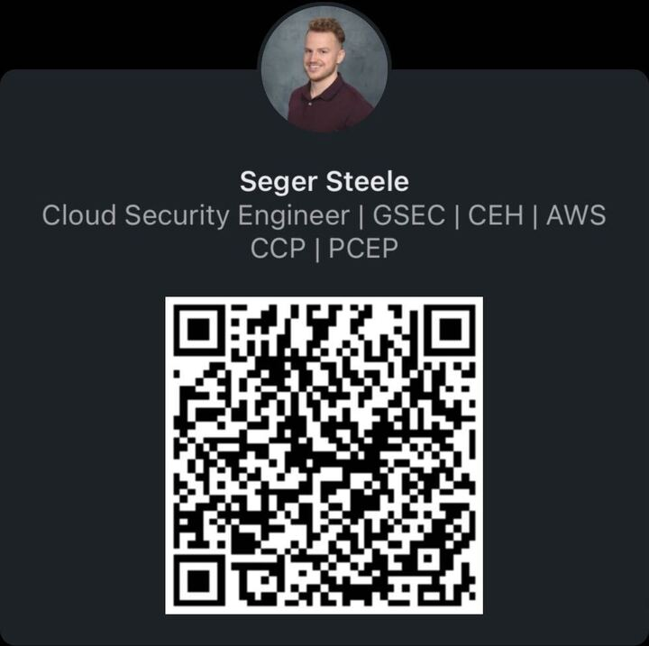
LET’S CONNECT!
Notes:
That’s all I had, here is a QR that will pull up my LinkedIn to connect.
We covered a lot of ground, does anyone have any questions or comments?
<answer questions or if there is none>
Alright, thanks for your attention, everyone!

